Slide 1
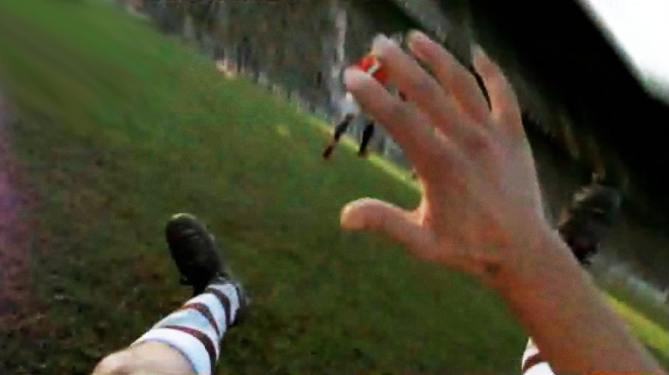
ELA Grade 7 The Power of Point of View, Lesson 3 Resource 3.3
Picture 1

Slide 2
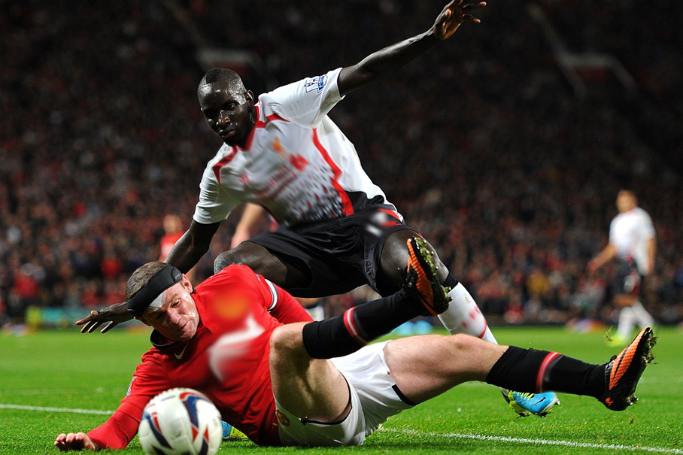
Picture 2

Slide 3
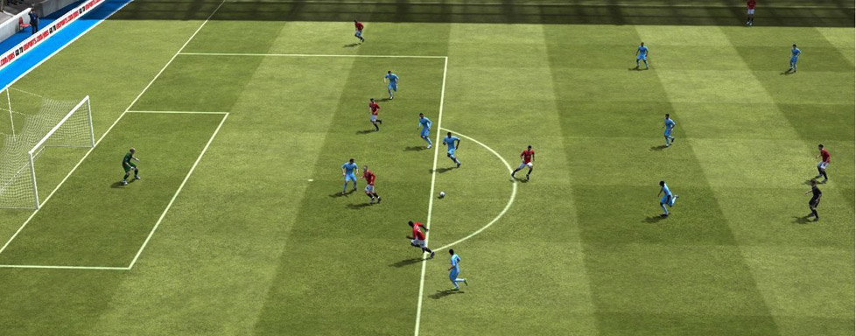
Picture 3

